Slide 1
Mock Stock
Theodore Hecht, Luke Orr, Sebastian Schwagerl, Jonathan Langston

Slide 2
Demo

Slide 3
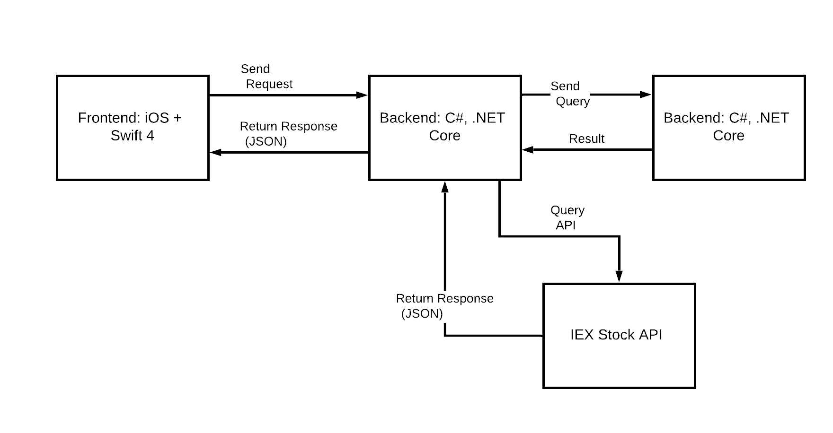
Overall System Design
Azure PostgreSQL Database

Slide 4
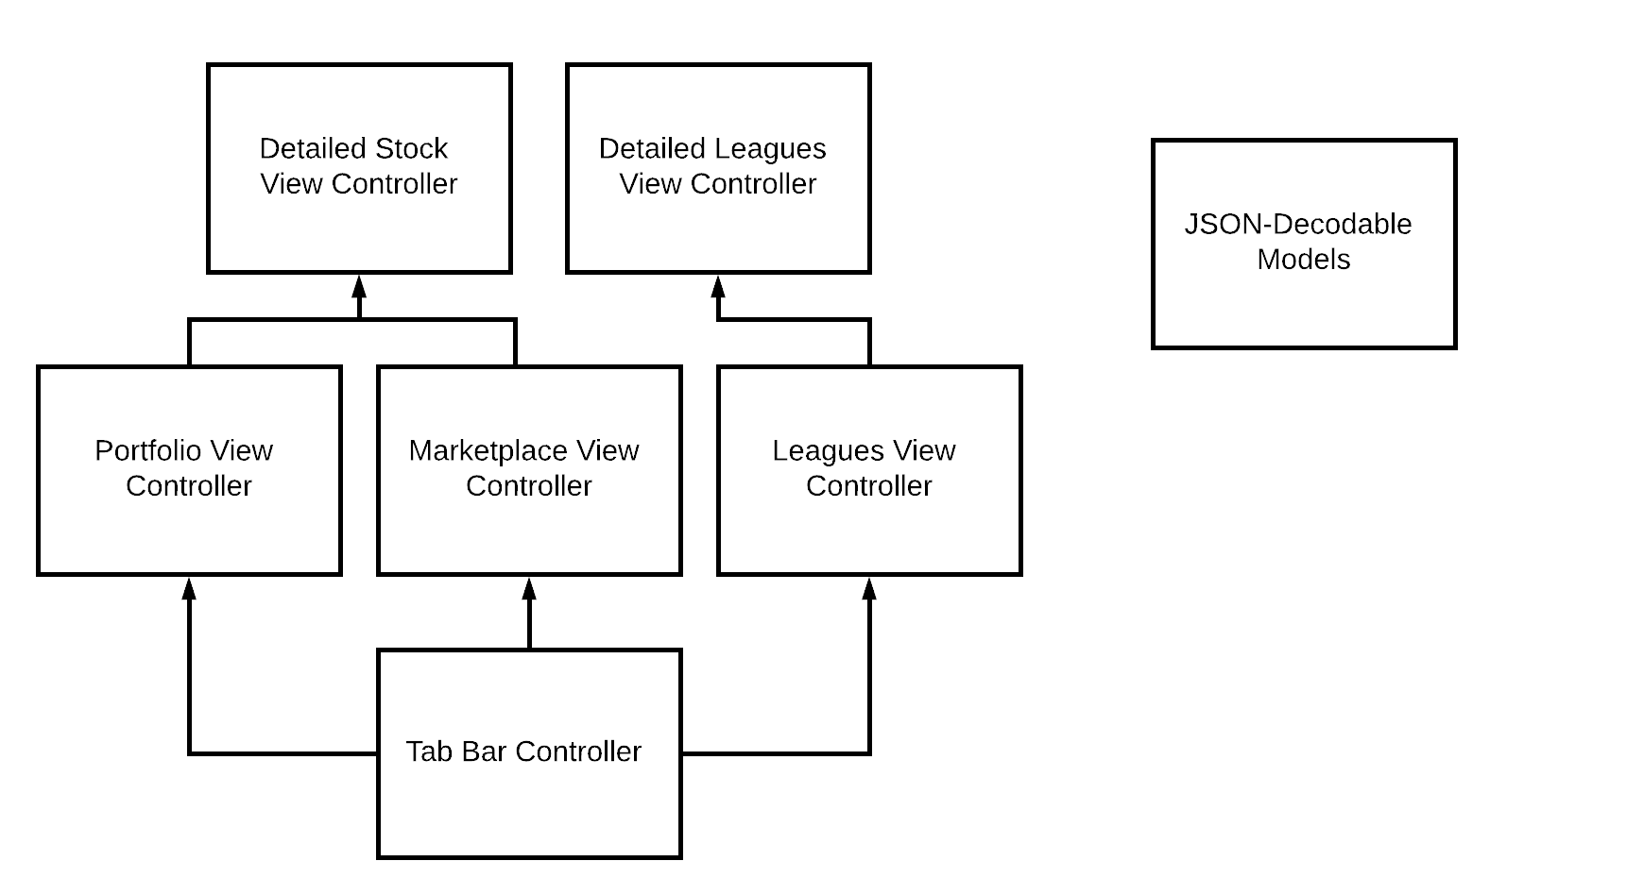
Overall System Design - Frontend

Slide 5
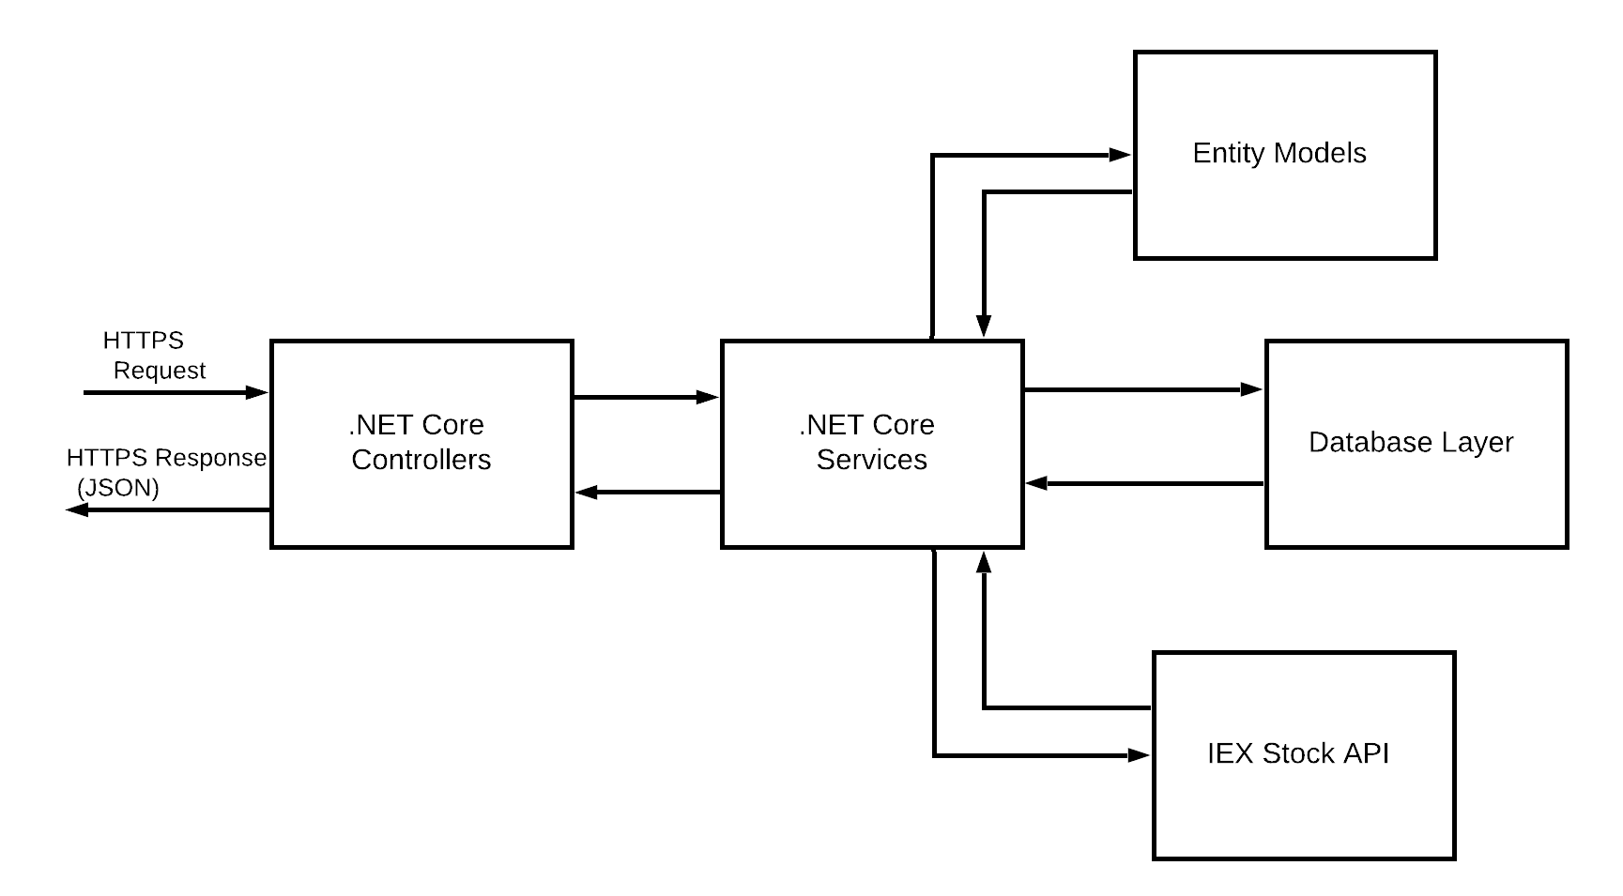
Overall System Design - Backend

Slide 6
Trey’s Subsystems

Slide 7
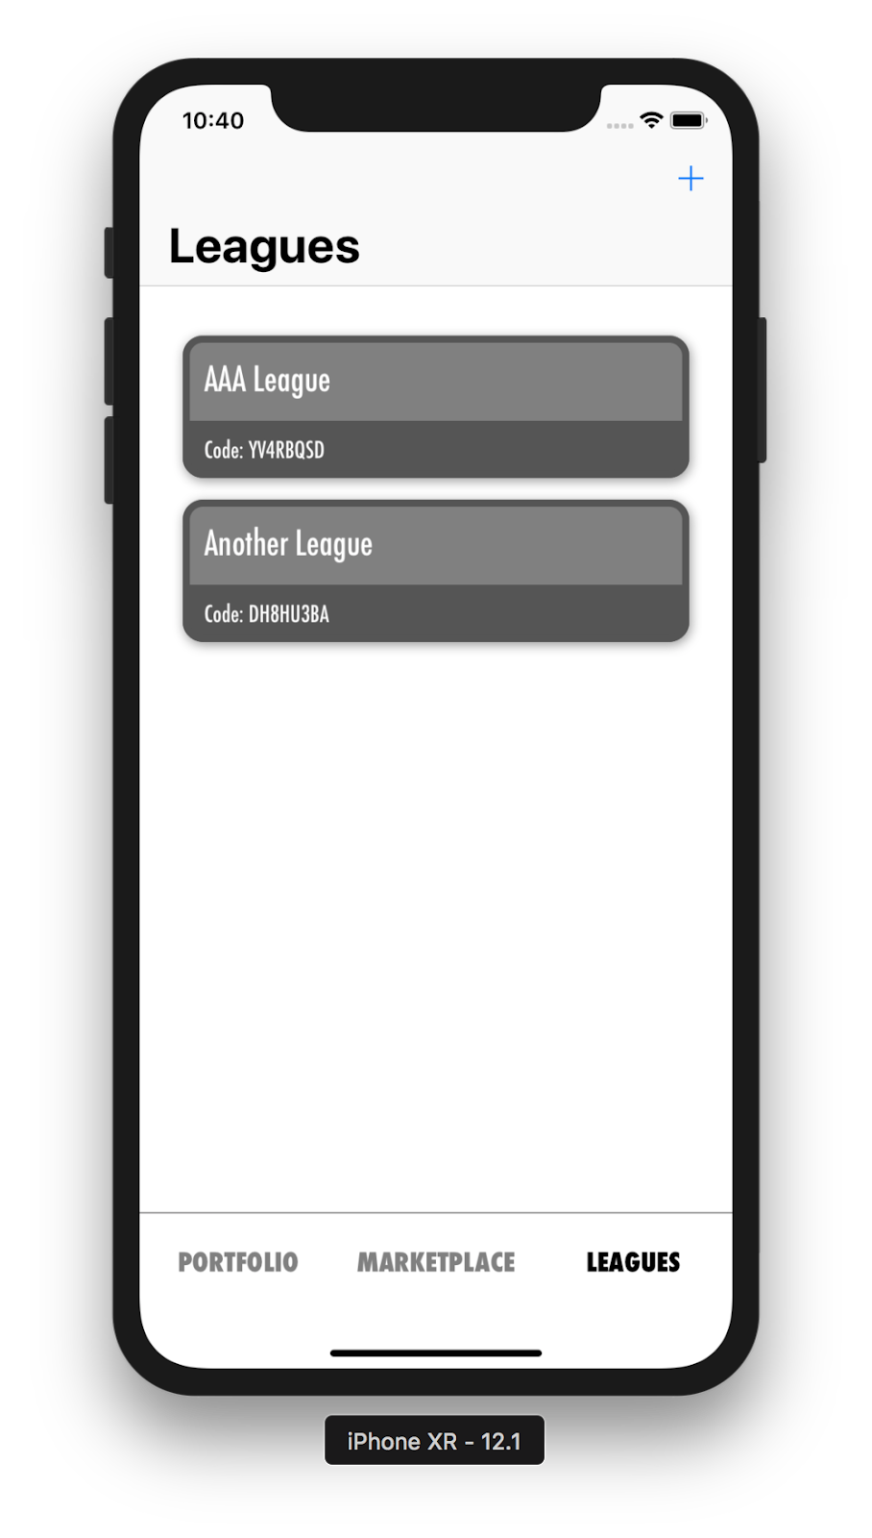
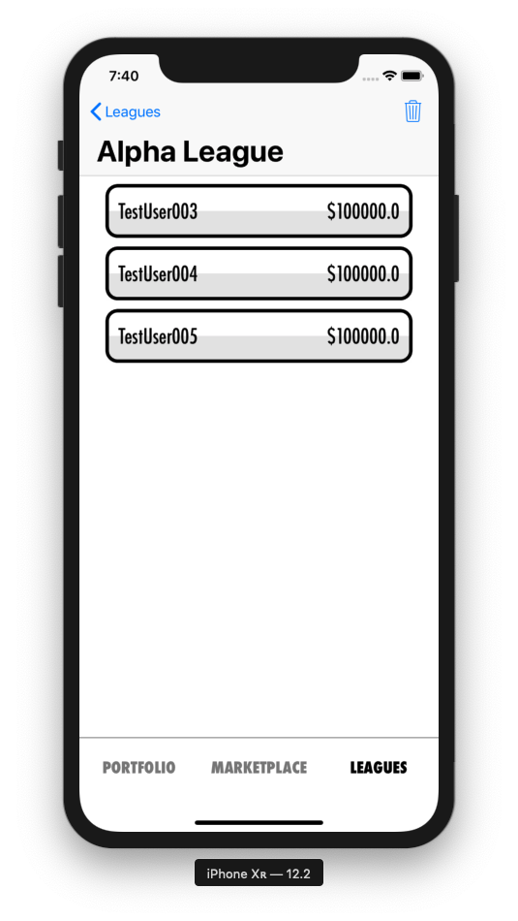
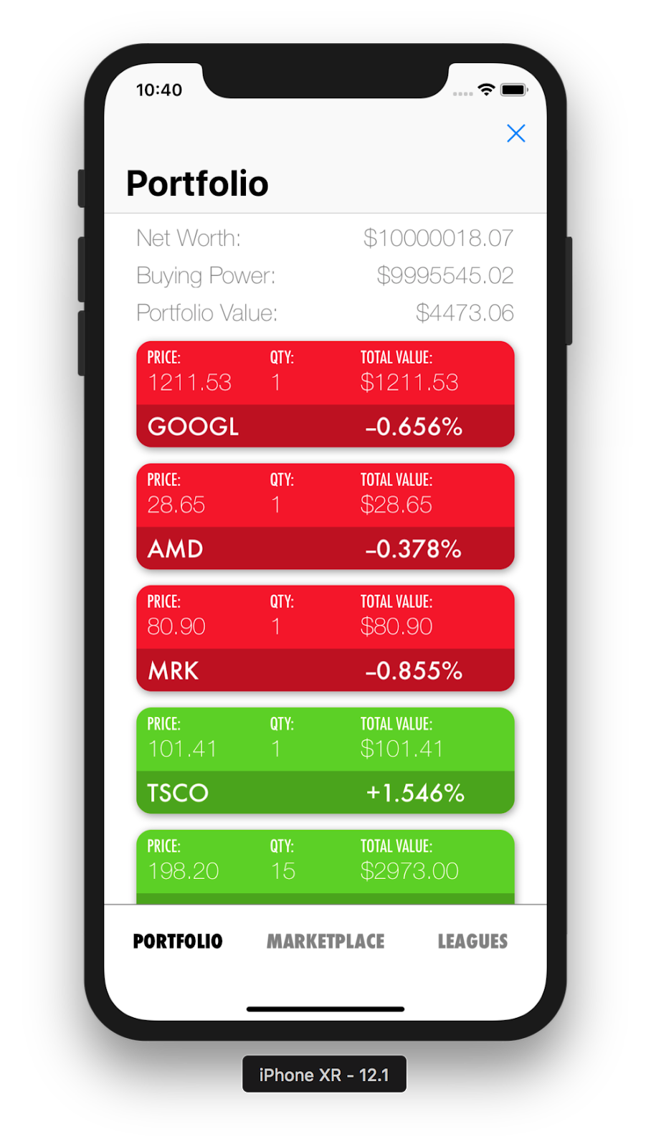
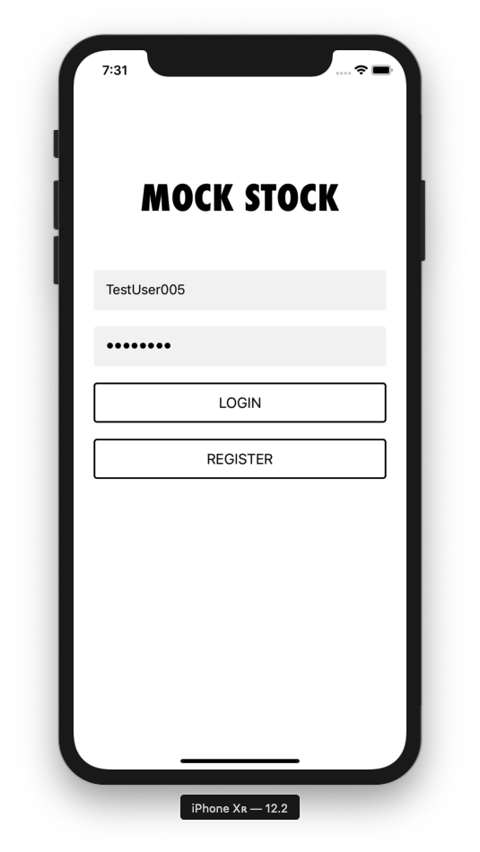
Portfolio + Leagues
Collection Views + Cells
Navigation Header
Navigation Buttons
Auxiliary Buttons

Slide 8
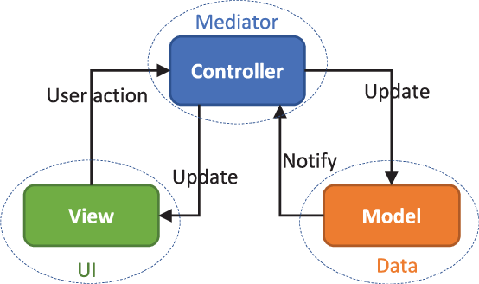
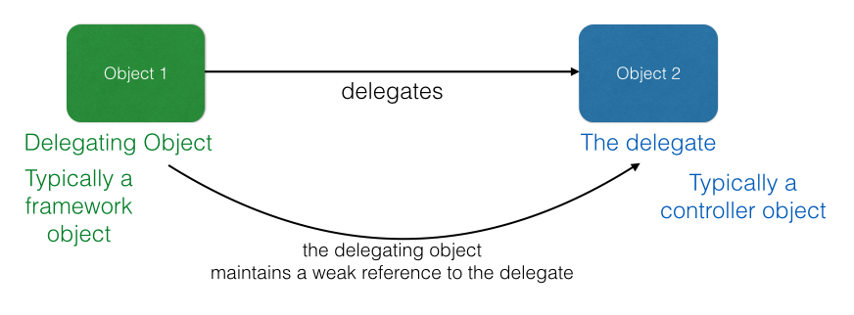
Miscellaneous Software Design Concepts
MVC - Model View Controller
Delegation
URLSession and the Decodable protocol

Slide 9
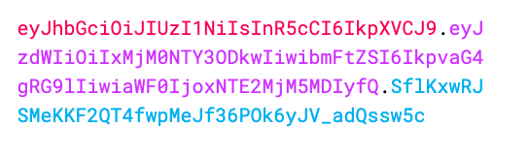
JWT Authentication
Replaces our “Basic Authentication” system
Requires username + password on token request
Token Generation:
Header + Payload + Signature
Future Requests don’t require username + password. Only the token.
JWT Token Example:

Slide 10
Luke’s Subsystems

Slide 11
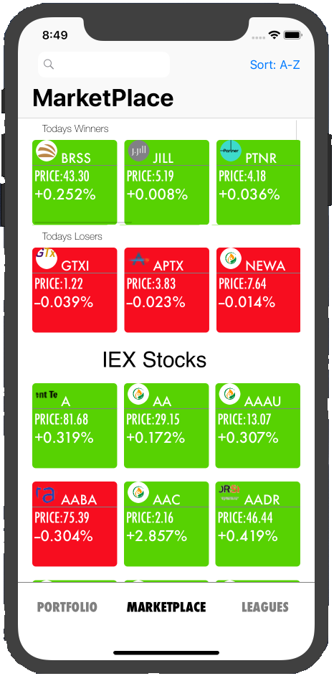
Marketplace View
Collection View Cells
Horizontal Uicollectionview
Navigation Header
Sort Button
Search bar

Slide 12
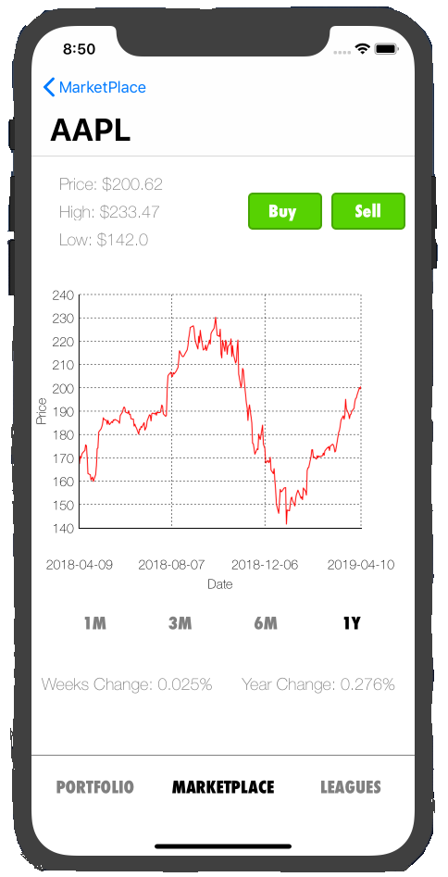
Detailed View
Navigation Header
UI Labels
Buy/Sell buttons
Graph View
Graph Button Bar

Slide 13
Tyler’s Subsystems

Slide 14
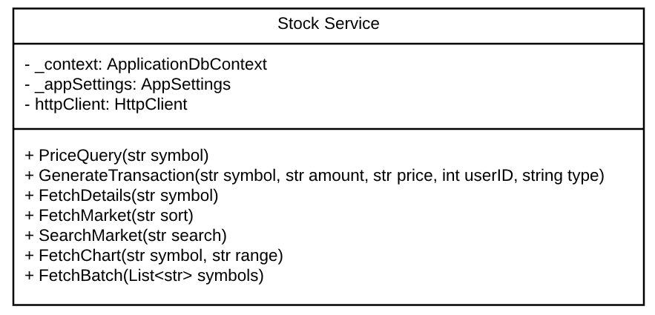
Stock Controller & Service
The Stock Controller handles any kind of interaction that users may have with stocks and the data fetching needed from the IEX API.
Stock Service return types are object representations of stocks.

Slide 15
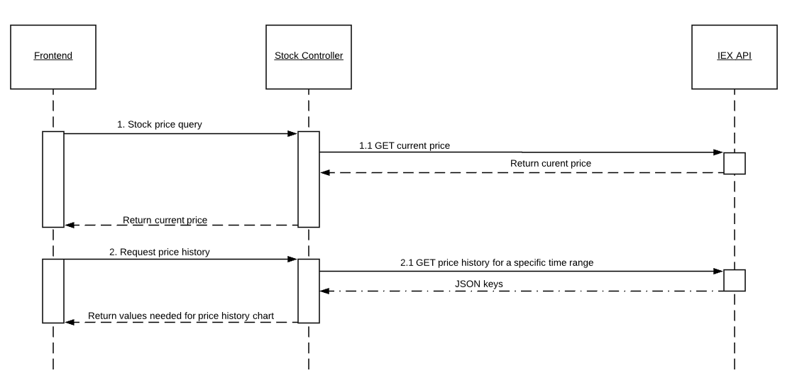
IEX API Communication
The Stock Controller requests the data from IEX and then needs to format it neatly in a usable way for the frontend in a JSON.
An HttpClient is needed in order to make HTTP requests in the code.
Important to note that the HttpClient should be reused and not open/closed repeatedly many times.

Slide 16
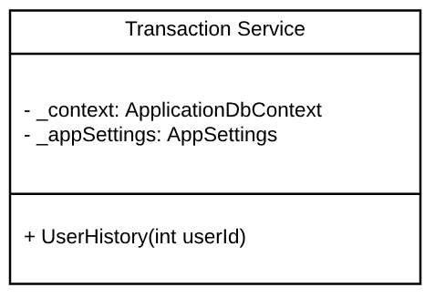
Transaction Controller & Service
The Transaction Controller is needed to provide methods that involve a user’s history of stock purchases and stocks sold.
The service returns a list of transactions from that user.

Slide 17
Sebastian’s Subsystems

Slide 18
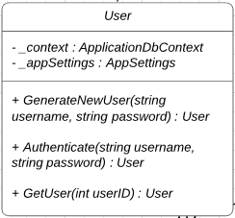
User Controller & Service
The User Controller handles generation and authentication of the user.
Authentication is our Login Method that hashes a user’s password, compares it to the database, and then signs a token that is checked upon every subsequent method called.
Modifying funds was intended to be handled within this method, though since it is always and only used when stock methods are called, it is being handled there.

Slide 19
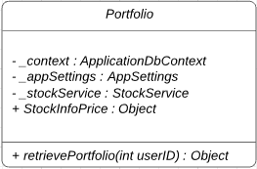
Portfolio Controller & Service
Portfolio retrieves all useful information about a user’s net worth.
The object it returns contains the available User Currency along with all owned stocks with their quantity.
It calls upon StockService’s FetchBatch method and retrieves a full list of stocks, while matching them with the IDs from a previous search to attach the quantity owned.

Slide 20
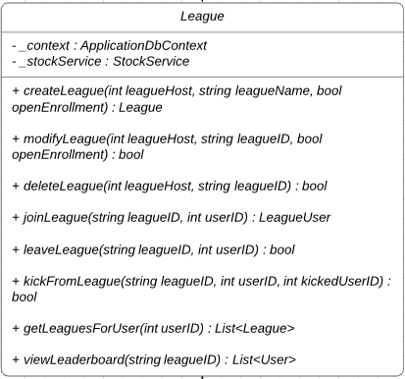
League Controller & Service
Handles all aspects of league creation and management.
The LeagueHost has exclusive powers such as deletion of their league and the ability to kick members.
ViewLeaderboard uses the StockService to get a batch price on every unique stock owned by the total LeagueUsers and then uses their available cash, and quantity of stocks owned to get each user’s net worth.

